Slide 1
STOCK PORTFOLIO SUGGESTION ENGINE CMPE 285 INSTRUCTOR – RICHARD SINN
PRIYANKA MADAS - 016649659
VANI VINEELA AREMANDA - 016131284
LAKSHMI SRI NITYA SUNKARA – 017459390
JEEVANA YAMINI DIVYA SRI MEDARAMETLA - 016387436

Slide 2
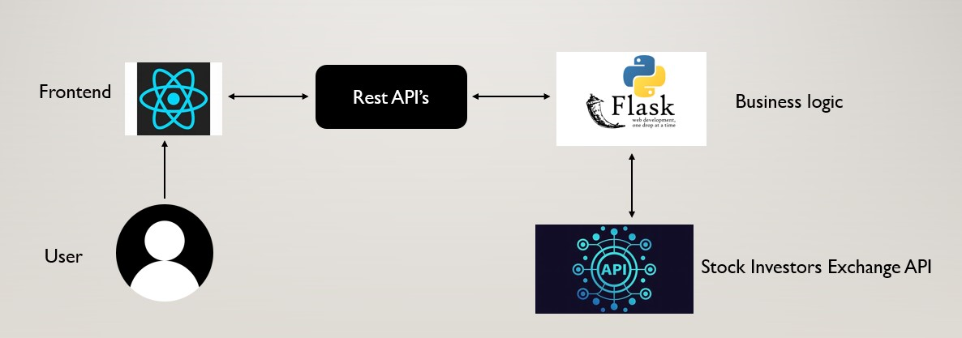
ARCHITECTURE

Slide 3


ARCHITECTURE COMPONENTS
Frontend:
Stock recommendation component based on Investing Strategies.
View history of stocks recommended.
View Portfolio details.
Clear Portfolio.
Backend:
Get Stock Details API.
Get stock suggestion API.
Buy Stocks API.
View Portfolio API.
Clear Portfolio API.

Slide 4
FEATURES
Choosing the appropriate investment price and type while ensuring input validation.
Analyzing past portfolio values to evaluate investment strategies.
Allowing users to decide on their preferred investment types, including ethical, growth, quality, value, and index investing.
Suggesting optimal distribution of investment amounts based on user preferences.
Providing a market overview widget for instant updates on index, commodity, bond, and forex prices.
Offering a real-time ticker for tracking various stock prices.
Incorporating a visual indicator to highlight fluctuations in stock prices for informed investment decisions.
Designing a frontend interface that is sleek, contemporary, and user-friendly.

Slide 5



CHALLENGES
Grasping the mechanics of the stock market and its functioning.
Collaborating with team members who have varying schedules.
Creating an effective and user-friendly interface tailored for users new to the platform.
Incorporating different software design practices during the project development.
Familiarizing oneself with diverse stock investment strategies.

Slide 6
TEST CASES 1/3
No. | Test Case Description | Expected Result | Actual Result | Status
1 | User selects Index investing with 5000$ amount and presses submit button | Stocks (4 in count), based on Investment strategies should be displayed to user. | 4 Stocks, based on Investment strategies are displayed to user with Stock name, Current price, Number of shares, Cost. | Passed
2 | User selects Quality investing with 6000$ amount | Stocks( 4 in count), based on Index investing strategy should be displayed to user. | 4 Stocks, based on Index investing strategy are displayed to user Stock name, Current price, Number of shares, Cost. | Passed
3 | User selects Value investing with 7000$ amount and presses submit button. | Stocks (5 in count), based on Investment strategies should be displayed to user. | 5 Stocks, based on Investment strategies are displayed to user Stock name, Current price, Number of shares, Cost. | Passed
4 | User selects Ethical investing with 8000$ amount and presses submit button. | Stocks (5 in count), based on Investment strategies should be displayed to user. | 5 Stocks, based on Investment strategies are displayed to user Stock name, Current price, Number of shares, Cost. | Passed

Slide 7
TEST CASES 2/3
No. | Test Case Description | Expected Result | Actual Result | Status
5 | User selects Ethical investing with 8000$ amount and presses submit button. | Stocks (3 in count), based on Investment strategies should be displayed to user. | 3 Stocks, based on Investment strategies are displayed to user Stock name, Current price, Number of shares, Cost.
6 | User selects a strategy and enters the amount and presses send button in postman | Stocks (6 in count), based on Investment strategies should be displayed to user. | 6 Stocks, based on Investment strategies are displayed to user. | Passed
7 | User selects multiple investing strategies with 10000$ amount | Stocks Suggestions based on the selected investment strategies should be displayed to user. | 3 Stocks Suggestions based on the selected investment strategies should be displayed to user. | Passed

Slide 8
TEST CASES 3/3
No. | Test Case Description | Expected Result | Actual Result | Status
8 | User posts data into buy stocks api using post method | User posts data into buy stocks api using post method | User got the portfolios list from portfolios api | Passed
9 | User enters an invalid symbol in the buy stock api | User should get an error message, “some error occured” | User should get an error message, “some error occured” | Passed
10 | User sends clear portfolio api to clear the portfolio daata | User should be able get empty dataset when he sends the portfolio api request | User got empty dataset when he sends the portfolio api request | Passed

Slide 9
FUTURE WORK
- Mobility : Introduce mobile app for on-the-go portfolio access.
- Real-time : Save and suggest personalized investment strategies
- Alerts : Enable daily email alerts for portfolio value tracking
- Personalization : Enhance live dashboards for real-time updates

Slide 10


